Slide 1
SPLIT Multi-D
Research 101;
Understanding the Basics of the Informed Consent Process
Tatiana Mendes Sa, CCRP
Senior Clinical Research Coordinator
Solid Organ Transplant Research
February 18, 2025

Slide 2
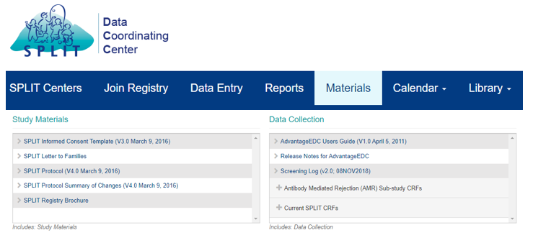
SPLIT Data Coordinating Center Website
Website: Materials Tab
Access to the SPLIT Website
Study Material
  Informed Consent Template
  SPLIT Protocol
Data Collection
  eClinical User’s Guide
    Guide to help site user’s navigate through eClinical.
    This guide is also available in eClinical under the ‘Materials’ tab.
  Current SPLIT CRFs
    Contains pdf versions of forms from eClinical
Notes:
2. IRB approval of the SPLIT Registry Protocol and ICF. Please update the informed consent template to meet any requirements of your local IRB, and send the document Emmes for review prior to submission to your IRB. If you have any questions as you work on the IRB submission, please let me know.

Slide 3
ICH E6 (R3) Good Clinical Practice (GCP)
The general concept of GCP is essential for any research study involving human subjects.
The two important goals of the ICH E6 standard are:
  To assure that the rights, well-being, and confidentiality of trial subjects are protected; and
  To assure that trial data are credible.
Following the ICH-GCP is one of the best ways to substantiate the quality of any research study and its resulting data.
Notes:
Whether conducting research involving a new drug or device, a behavioral intervention, or an interview/survey, GCP provides investigators and study teams with the tools to protect human subjects and collect quality data.

Slide 4
Essential Documents: Site Regulatory Binder
“Essential documents are those documents which individually and collectively permit evaluation of the conduct of the trial and the quality of the data produced. These documents serve to demonstrate the compliance of the investigator, sponsor and monitor with the standards of Good Clinical Practice and with all applicable regulatory requirements” (ICH Guideline E6).
Site Regulatory Binder
Informed Consent Forms
  All approved versions of informed consent.
IRB Approvals
  Continuing Reviews, modifications, etc
Screening/Enrollment Log
  A screening log records all potential subjects who are reviewed, contacted, pre-screened or screened for possible entry into a study. Should document why potential subjects were not included in study.
  A subject enrollment log records chronological enrollment of subjects. subjects who have signed a consent form.
Delegation of Authority Log/Signature List
  List of all individuals (including signature and initials) for all persons that are delegated study related activities by the PI.
  Update this log in a timely manner as new personnel are added and/or study roles change.
Non-Compliance Logs
May be physical or an eBinder (with appropriate security)
Protocol & Amendments
Informed Consent Forms
IRB Approvals
Training Log
Delegation of Authority Log
Subject Screening/Enrollment
Data Collection Manual
Non-Compliance Logs
Conflict of Interest Disclosures
Contracts/Agreements
Study Team Qualifications
Correspondence
Notes:
If you look up the ICH guidelines there are pages and pages of what they consider “essential documents” but for the purposes of this course I’ve watered it down a bit and I’m going to go over some the key documents that all studies can utilize.
All versions of the protocol starting from when we began the study at our site (the version in our agreement)
Informed consent forms, all approved versions, assent, non-English etc
Sponsor correspondence – this could be the FDA ok to proceed letter to the Sponsor naming our site or a letter from the sponsor for activation
IRB correspondence – the submissions and the review responses (stipulations or approval letters)
Investigator’s Brochure – all versions
Drug accountability logs – a NTF stating where these are kept if they are not with you (research pharmacy)
Training logs – topic, date, mode (virtual/self/SIV etc) full name and attestation to training for each protocol amendment
Delegation of authority logs – tells who is authorized to do what on the study team
Subject screening/enrollment tracking/recruitment – enrollment forms/ screening logs
Data collection manual – if you have a guide from the sponsor for how to enter data
Adverse event reports/logs – these might be kept in subject binders instead
Non-compliance logs – protocol deviations
Monitoring reports – only from sponsor/CRO not for internal audits or self quality assurance tools
Contracts/agreements – a NTF of where this is kept, be able to pull it up in project tracking if needed
Conflict of interest disclosures - we keep these in iRIS now, but be sure to know how to access them if you need to
PI / Sub I CVs, medical licenses, GCP CITTI certifications, any staff shipping biospecimen IATA training certifications

Slide 5
Delegation of Authority Log
Per ICH E6 GCP, an investigator should maintain a list of appropriately qualified persons to whom the investigator has delegated significant trial-related duties. Additionally, a signature sheet to document signatures and initials of all persons authorized to make entries and/or corrections on CRFs is listed. The list should describe the delegated tasks, identify the training that individuals have received in order to perform delegated tasks, and identify the dates of involvement in the study.
Notes:
Per ICH E6 GCP, an investigator should maintain a list of appropriately qualified persons to whom the investigator has delegated significant trial-related duties. Additionally, a signature sheet to document signatures and initials of all persons authorized to make entries and/or corrections on CRFs is listed. The list should describe the delegated tasks, identify the training that individuals have received in order to perform delegated tasks, and identify the dates of involvement in the study.

Slide 6
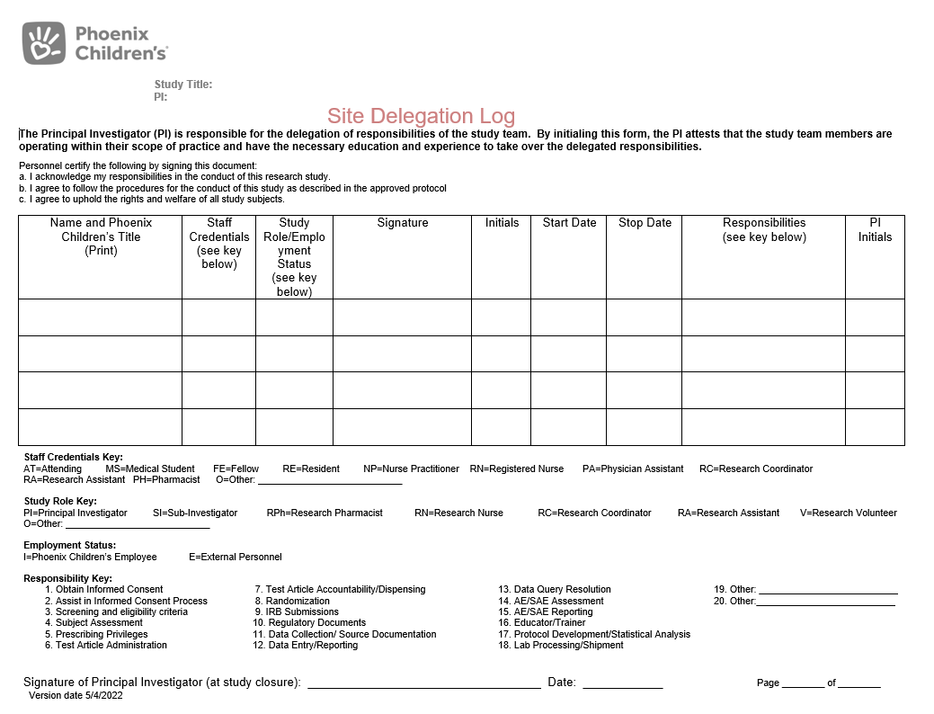
Site Delegation Log

Slide 7
What is Informed Consent?
A process of information exchange that takes place between the prospective subject/LAR and the investigator/designee before, during, and sometimes after the study.
More than just signed consent form

Slide 8
Who Can Obtain Consent?
Only individuals listed on the study delegation log as designated to obtain informed consent, & are qualified by education, training, and experience are authorized to obtain informed consent.
  PI remains responsible for ensuring study is carried out properly (including consenting)

Slide 9
Who Can Sign Informed Consent?
Subjects 18 or older
  Self
  LAR (if subject lacks cognitive/emotional capacity to consent, as determined by physician/PI)
  **Subjects with diminished capacity (cognitive impairment, communication difficulties, or mental health related issues) should not sign an informed consent**
Subjects under 18
  Parent(s)/LAR
  8–17-year-olds should provide Assent
Legally Authorized Representative (LAR) To Sign:
  Must have legal authority to sign for the subject
  Biological parents and adoptive parents can sign
  All other relationships to potential subject --> speak to your manager prior to allowing them to sign (may need to contact legal for guidance)
  Biological mothers less than 18 years of age can consent for their child if the mother has the capacity to understand the proposed study (check with manager prior to moving forward). The same does not automatically apply to a father.

Slide 10
Assent/Re-Consent
Assent for Minors 8 years of age up to 18 years of age
Assented Minor Reaches Age of Majority
Our local IRB requires children 8 years of age and older assent for their participation in research.
**check age requirement with local IRB**
Explains the study at a level the child can understand
When a subject reaches age 18 years (and has the mental capacity) and is still on study, the subject must be consented on the currently approved consent.
No further research can occur until the subject consents
  This includes any further data collection
  If it is a long-term study, the subject cannot be reached, and the subject is considered LTFU, no further data collection can occur
Notes:
Phoenix Children's requires children 8 years of age and older assent for their participation in research

Slide 11
What is Included in an Informed Consent?
8 Elements are Required Per 45 CFR 46.116(b):
That the Study Involves Research, and an Explanation of the Purpose of the research.
Description of any reasonably Foreseeable Risks and Discomforts
Description of Benefits
Disclosure of appropriate Alternatives Procedures, if any, that might be advantageous to the subject
Extent to which Confidentiality will be Maintenance
Statement about Treatment and Compensation for injury, if available.
Contact information for research and research subject's rights questions
Voluntary Participation and Withdrawal Information
*A Statement About Personal Health Information or Identifiable Biospecimens
Expected duration of the subject's participation
*Six Additional Elements (if applicable to study)
Notes:
Required Elements (8) FDA
A statement that the study involves research, an explanation of the purposes of the research, the expected duration of the subject’s participation, a description of the procedures to be followed, and identification of any procedures which are experimental
A description of any reasonably foreseeable risks or discomforts to the subject
A description of any benefits to the subject or to others which may reasonably be expected from the research
A disclosure of appropriate alternative procedures or courses of treatment, if any, that might be advantageous to the subject
A statement describing the extent, if any, to which confidentiality of records identifying the subject will be maintained and that notes the possibility that the FDA may inspect records
For research involving more than minimal risk, an explanation as to whether any compensation and an explanation as to whether any medical treatments are available if injury occurs, and, if so, what they consist of, or where further information may be obtained
An explanation of whom to contact for answers to pertinent questions about the research and research subjects’ rights, and whom to contact in the event of a research-related injury to the subject
A statement that participation is voluntary, that refusal to participate will involve no penalty or loss of benefits to which the subject is otherwise entitled, and that the subject may discontinue participation at any time without penalty or loss of benefits to which the subject is otherwise entitled
Why do the informed consent process?
Protects human subjects (FDA)
Gives the subject all the information that he/she would reasonably want to know about a study including the risks/benefits (ICH)
Ensures that the subject understands what they will be agreeing to (ICH)
Discusses the individual’s rights as a research subject (ICH)
Gives the subject the opportunity to agree to participate (ICH)
The investigator is responsible for ensuring the rights, safety, and welfare of subjects under the investigator’s care

Slide 12
Research Consent Documentation
This document is a record of the informed consent process. It states that best practices were followed during the informed consent discussion.
Federal guidelines require documentation of consent.
Best practice to document everything that you do with a potential subject/LAR.
  If it was not documented, it wasn't done in terms of auditors.

Slide 13
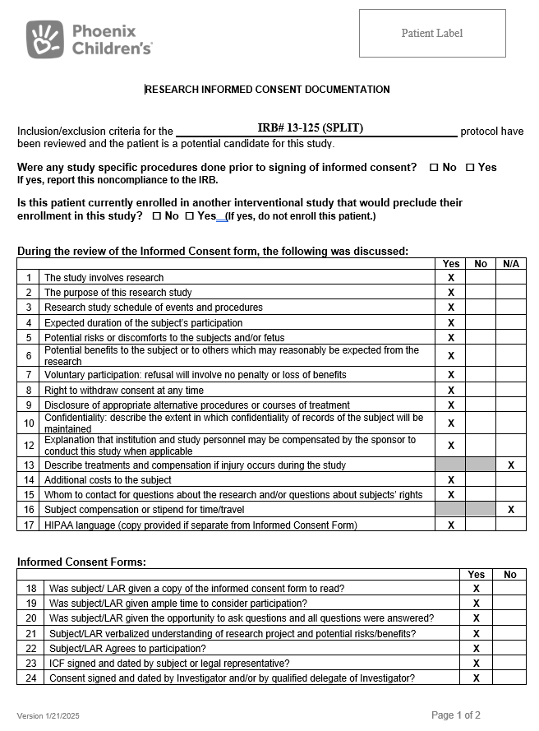
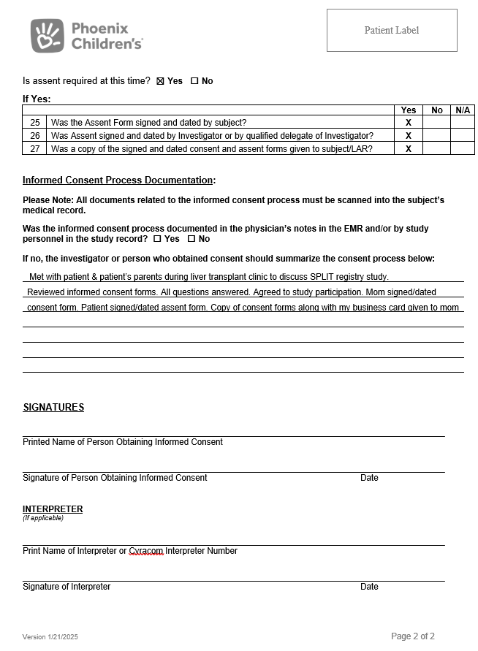
Research Consent Documentation Checklist

Slide 14
Consent Reminders
No research study activity should be initiated prior to obtaining informed consent.
Ensure the most current informed consent form is used, and that it is not expired.
Ensure that all informed consents that you are using have been IRB approved and have been stamped by the IRB.
Retain the original and make 2 copies
  Subject/LAR
  Medical Record scanning
Complete the Research Documentation Checklist.

Slide 15
Effective Informed Consent Process Has ALL the Following
Privacy for the participant
Language understandable to the potential subject (6th grade reading level)
Opportunity for the potential subject to consider all options
Assurance that the potential subject comprehended the information provided (open-ended questions, teach back)
Obtaining the subject's voluntary agreement to participate
Documenting the consent process appropriately
Providing copies of the consent documents to the subject
Continuing to provide information to the subject as the study progresses

Slide 16
Thank you!

